Slide 1
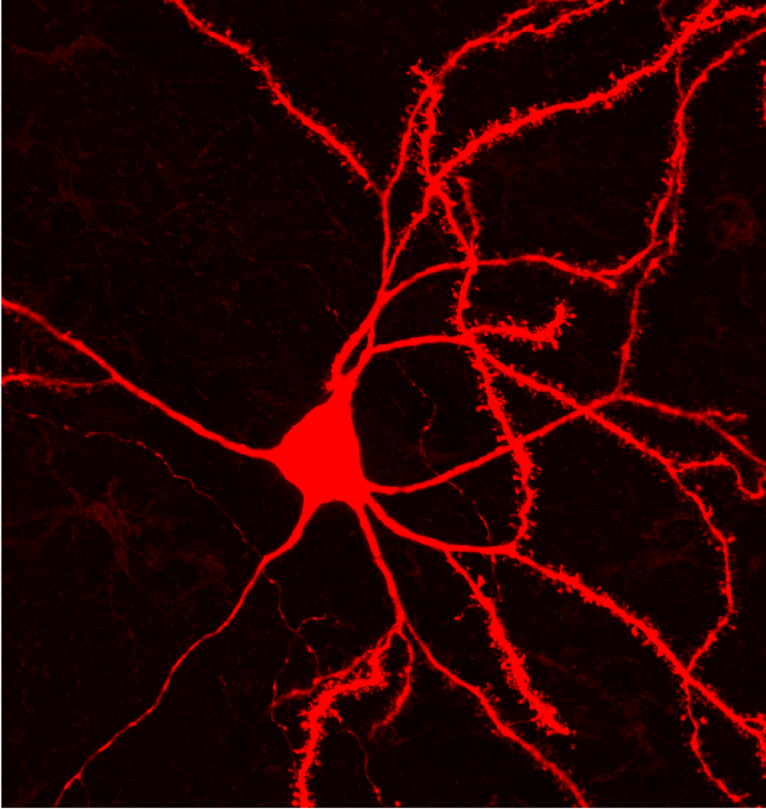
Spiny Projection Neurons
in the
Dorsal Medial Striatum
Data Presentation
CSHL Ion Channels Course
Magill Lab

Slide 2
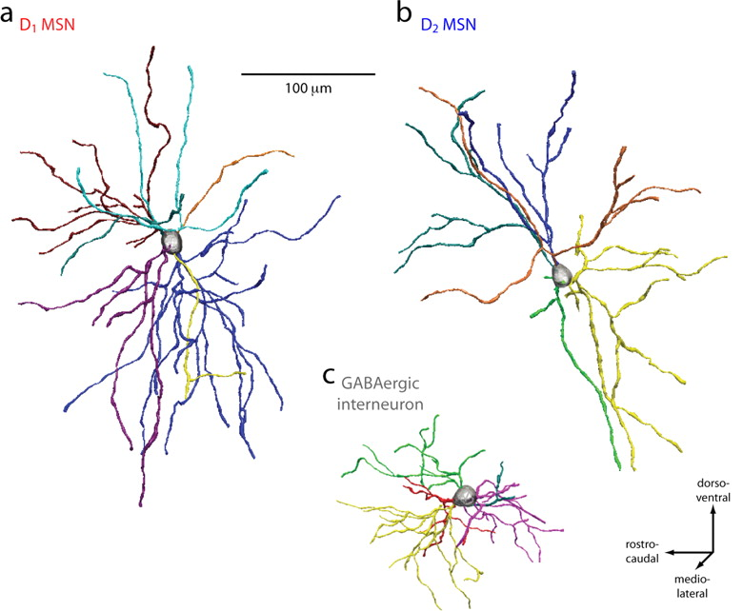
Brief intro to SPNs
95% of cells in the striatum
Inhibitory
Sit hyperpolarized ~ -90mV due to Kir2 channels (inwardly rectifying K+)
2 major classifications of SPNs - D1 (dSPN) and D2 (iSPN) with slightly different physiological properties
Gertler et al., 2008

Slide 3
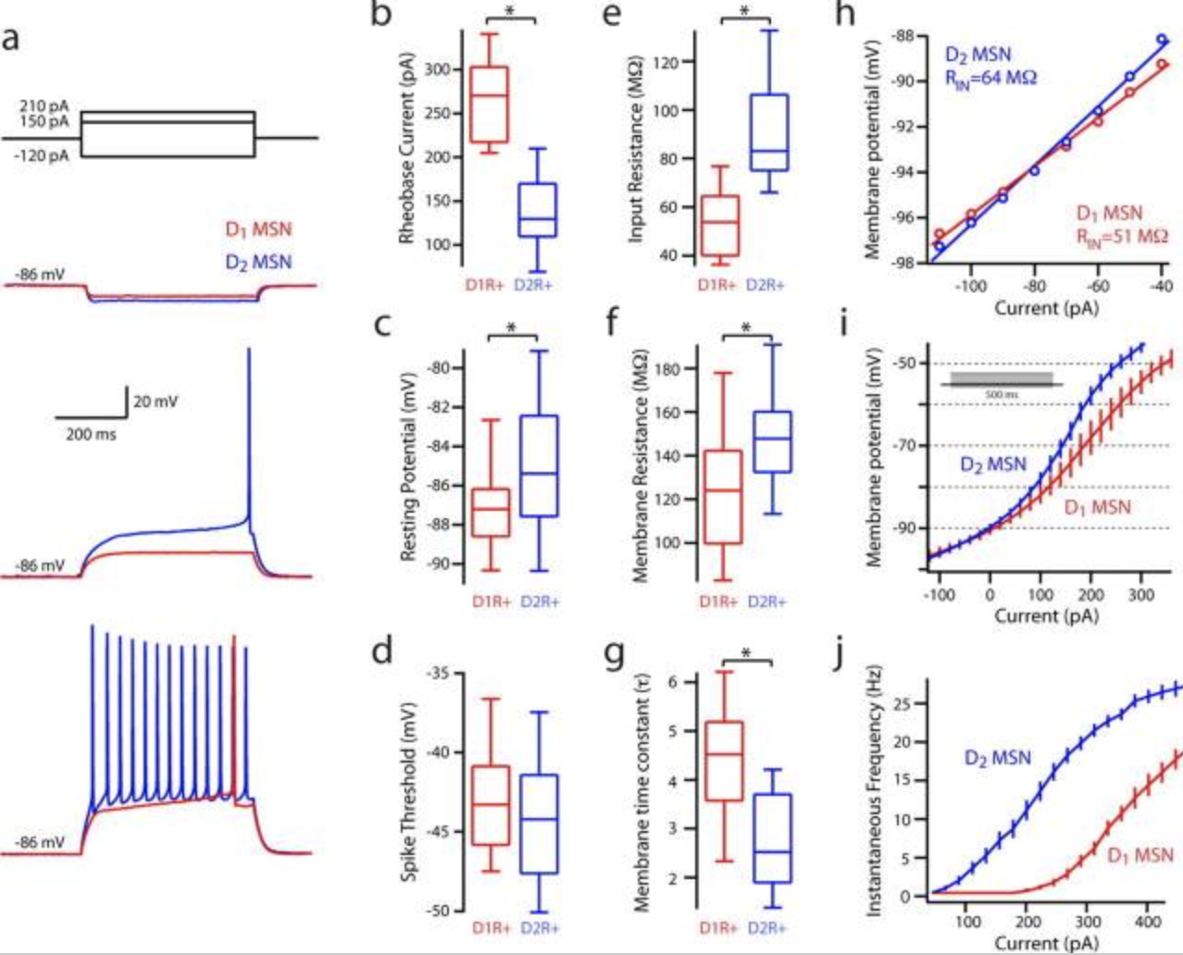
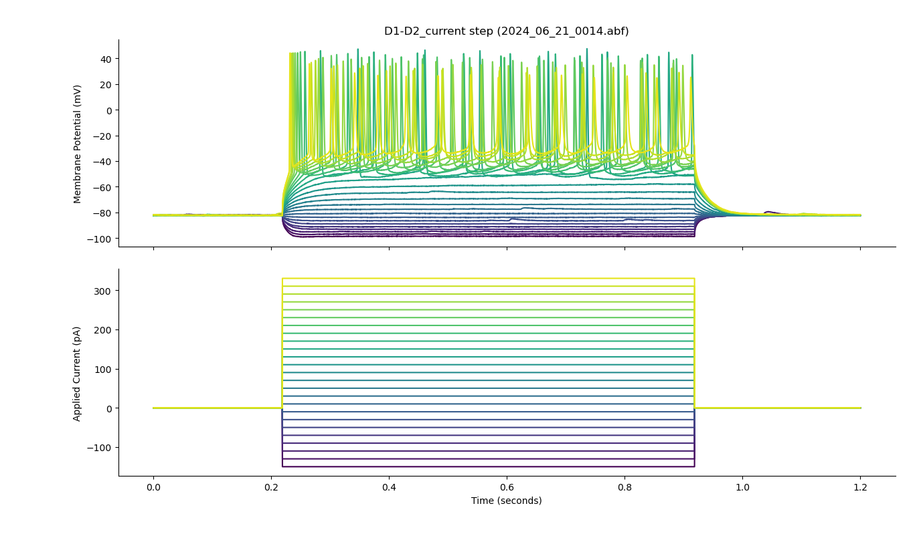
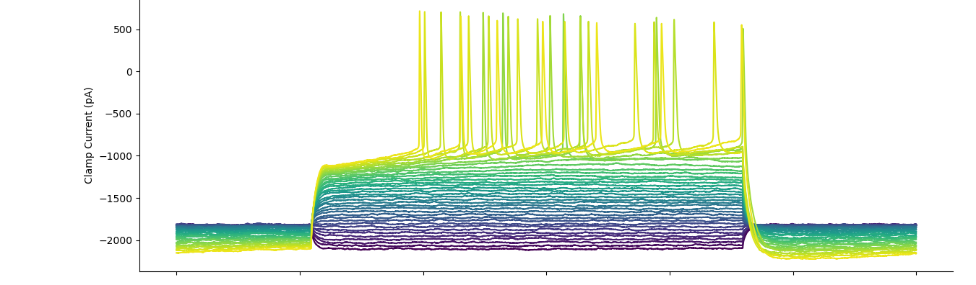
Recordings from putative SPNs - replication of Gertler et al., 2008
K+ equilibrium potential: ~-85
Average RMP during recordings: ~- 80mV

Slide 4
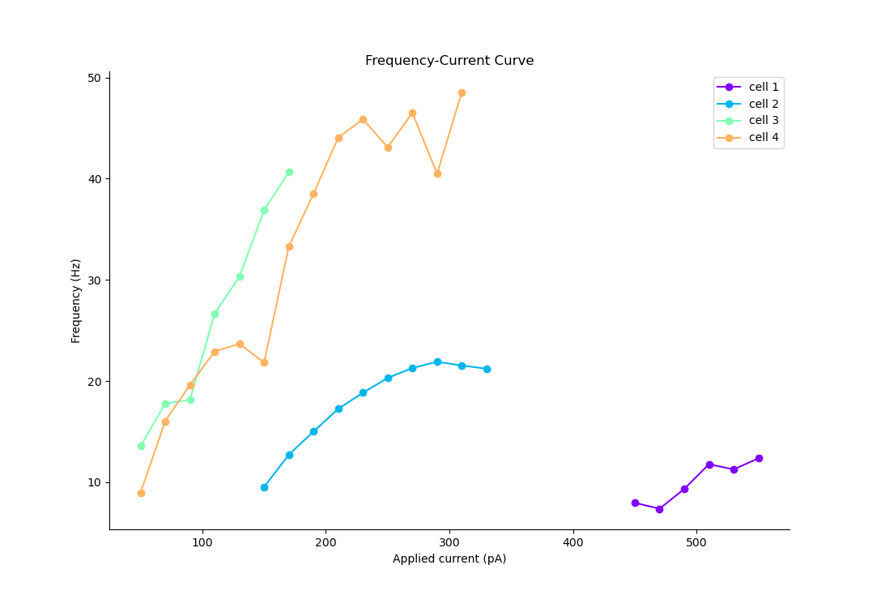
Different firing patterns across cells
Possibly, multiple D2s and one D1?
Gertler et al., 2008

Slide 5
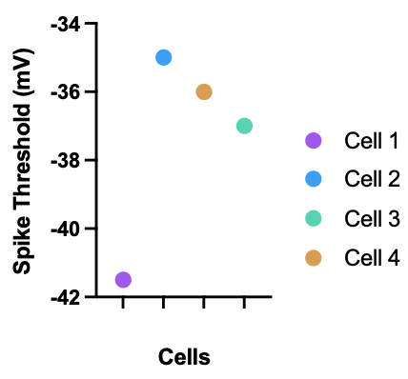
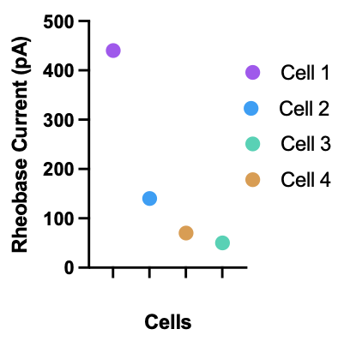
Different firing patterns across cells
Possibly, multiple D2s and one D1?
Gertler et al., 2008

Slide 6
Reminders (what I should have/will do)
Bridge balance - compensating series resistance
Have a test pulse
Pay attention to internal (many striatum papers use KMeSO4 instead of K+ gluconate)
THANK YOU!

